Slide 1
Creative Works in Our Core French Classroom Polly Dobie – Point Grey Secondary Vancouver School Board Modern Languages Pro-d February 19, 2018

Slide 2
Reading
Writing
Listening
Speaking
(Production)
Speaking
(spontaneousl)y
TEXT

Slide 3
SELF & OTHERS
The positive personal and cultural identity competency involves the awareness, understanding, and appreciation of all the facets that contribute to a healthy sense of oneself. It includes awareness and understanding of one’s family background, heritage(s), language(s), beliefs, and perspectives in a pluralistic society.

Slide 4
CULTURE

Slide 5
A student’s perspective-Cultural ripples
Moi-même
Ma famille
Ma commaunauté
Ma ville
Ma région
La Colombie-Britannique (Franco-Colombiens)
Les francophones au Canada (Québec, Nouveau-Brunswick, franco-ontariens, franco-albertans, franco-colombiens….)

Slide 6
The communication competency encompasses the set of abilities that students use to impart and exchange information, experiences and ideas, to explore the world around them, and to understand and effectively engage in the use of digital media.

Slide 7
Critical thinking involves making judgments based on reasoning: students consider options; analyze these using specific criteria; and draw conclusions and make judgments. Critical thinking competency encompasses a set of abilities that students use to examine their own thinking, and that of others, about information that they receive through observation, experience, and various forms of communication.

Slide 8
Social responsibility involves the ability and disposition to consider the interdependence of people with each other and the natural environment; to contribute positively to one’s family, community, society, and the environment; to resolve problems peacefully; to empathize with others and appreciate their perspectives; and to create and maintain healthy relationships.

Slide 9
Personal awareness and responsibility includes the skills, strategies, and dispositions that help students to stay healthy and active, set goals, monitor progress, regulate emotions, respect their own rights and the rights of others, manage stress, and persevere in difficult situations. Students who demonstrate personal awareness and responsibility demonstrate self-respect and express a sense of personal well-being.

Slide 11
New curriculum
know
do
understand

Slide 12
culture
viewing
reacting
questioning
comparing
understanding

Slide 13
New Curriculum – Big Ideas

Slide 14
Example of responding to culture
Poème trouvé

Slide 15
The importance of digging into the vocabulary & interacting with text before making the found poem
How could you categorize the text?
(theme, chronology, concrete elements, other…)
Re: Mon enfance au Viêt-nam (Yvette Chaux)
Use JIGSAW (HOMEGROUP / EXPERT GROUP STRATEGY)
A. les animaux (ex: les petits poussins ou oisons…)
B. nature (plantes, lieux géographiques, la météo, la villes)
C. les rélations (membres de la famille, les amis…)
D. les actions physiques (ex: faire des balades…)

Slide 16
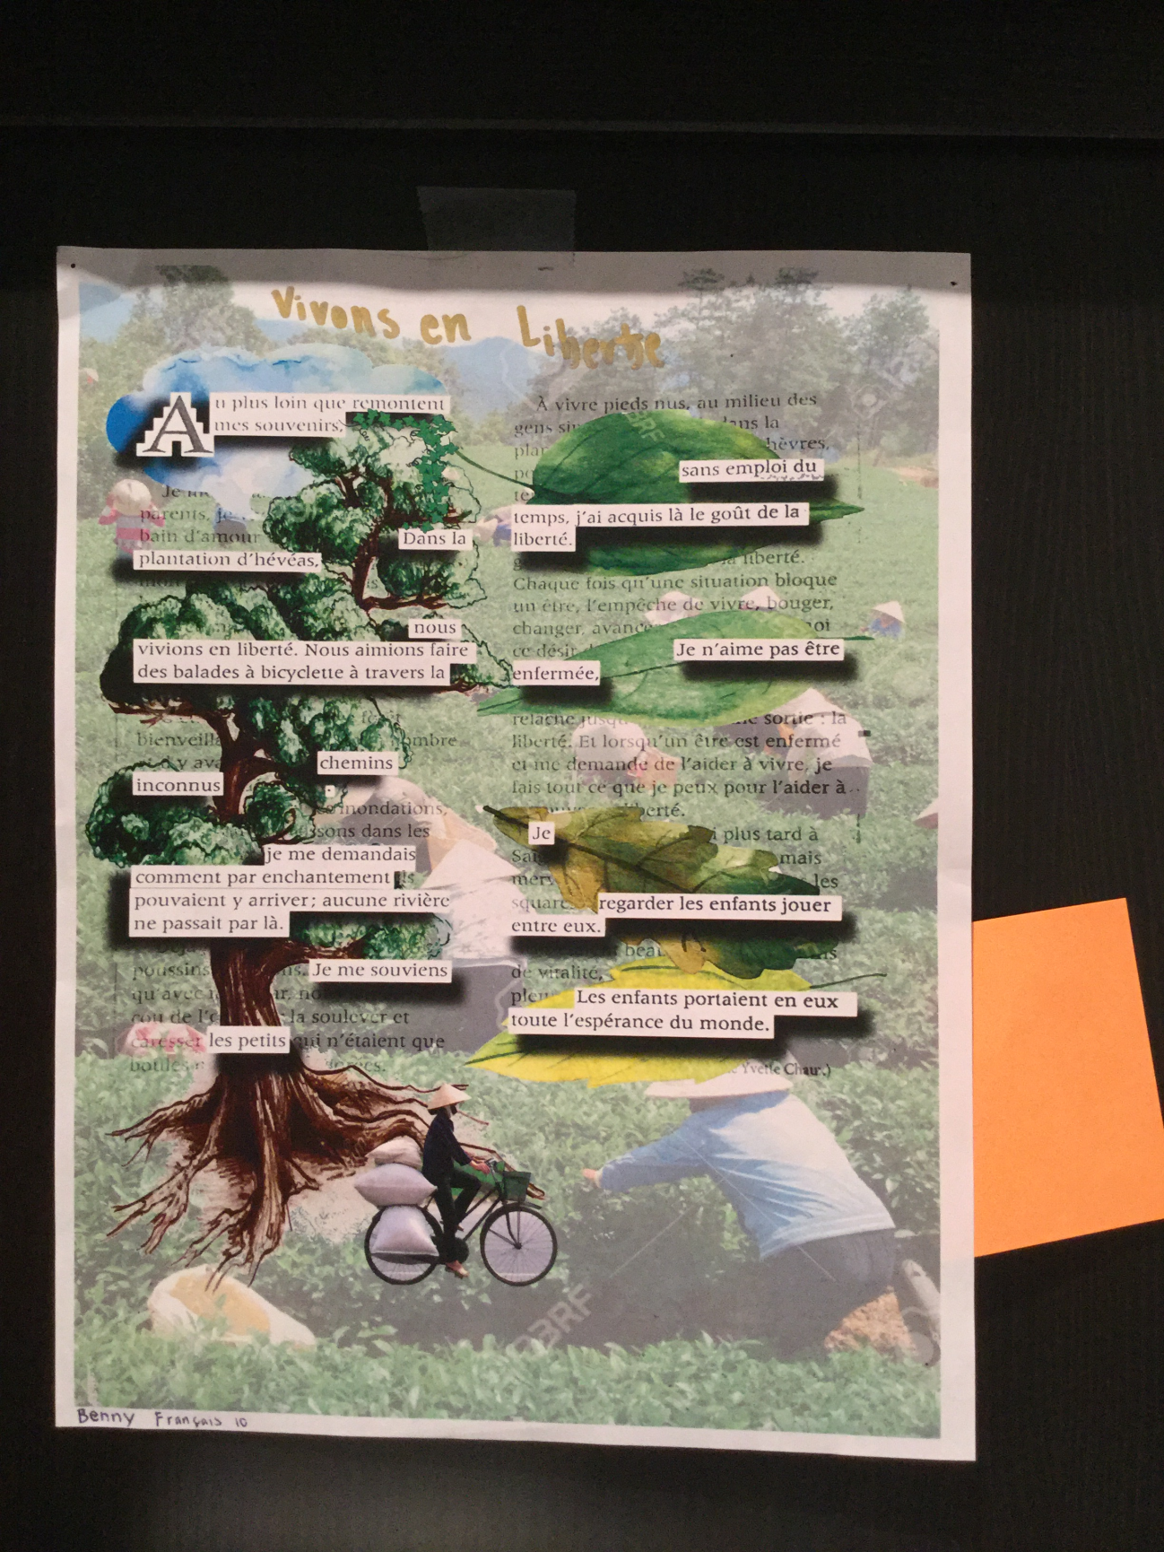
Poème trouvé – français 10 point grey
Fait par Benny

Slide 17
Trouvez la liberté (de shannon )

Slide 19
Tirer les textes de non-fiction

Slide 20
Poème trouvé tiré du texte de non-fiction – jacques cousteau
Directions: You can do the same activity with a non-fiction piece.
Choose one strong in sentiment with a variety of rich vocabulary.
Biographies –one page
News Articles- short
*Repetition is a useful strategy*s

Slide 21
Poème trouvé tiré du texte de non-fiction – jacques cousteau
La purité perdue des océans,
Est un grand problème pour nos enfant.
On doit adopter une résolution
Pour mettre une fin à la pollution.
C’et nos droits de protéger l’environnment,
La nature nous donne seulement une chance.
C’est à nous de faire la différence.
Sauvez la mer, sauvez l’air, sauvez la terre!
Écrit par: Aaron

Slide 22
Extending thinking extended thinking – making personal connections
Freewrite-
L’écriture libre

Slide 23
Règles:
Ecrivez, écrivez, écrivez
Ne faites pas attention aux ‘fautes’
Ne changez pas (pas de rédaction)
‘franglais est permis’
Ne parlez pas, Ne dérangez pas vos camarades de classe

Slide 24
Ecriture libre….
Pensez à un endroit préféré (de votre enfance ou maintenant)
Décrivez-le.
Note:
You may need to do a bit of a ‘guided writing’ (prompt them with ideas depending on their level.)

Slide 25
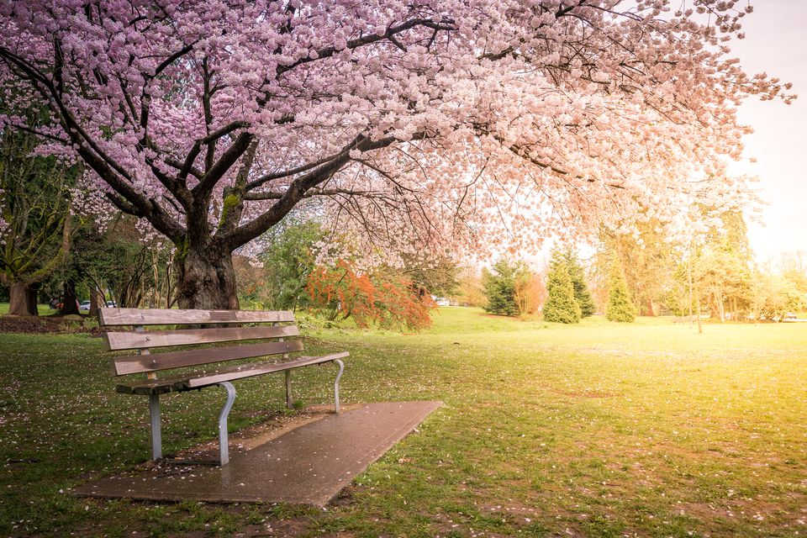
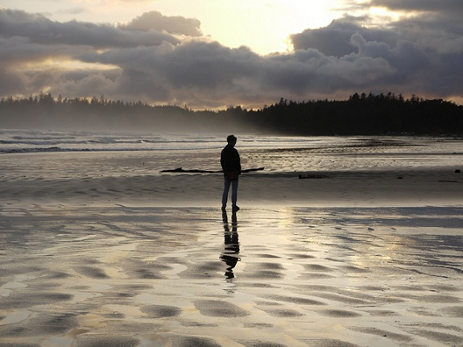

Slide 26
Further extention
After writing, share with a partner
Partagez vos souvenirs de votre lieu préféré
Partner has the ‘question fan’
Qui, Quoi, Quand, Pourquoi, Depuis quand, Comment, Où, Avec qui, Que
Or – create a FOUND POEM from this piece using a roll of the dice.

Slide 27
Using dice to make a found poem.
Read over your piece…
highlight 5 clumps of words that feel important, have an image.
Number these ‘lines’
(DO NOT UNDERLINE THE ENTIRE PHRASE)
Rewrite these new lines at the bottom of the page.

Slide 28
Teaching strategy: Dice/ les dès

Slide 29
Moving from prose to poetry
Students have their 5 ‘lines’ of poetry in front of them.
Have them roll the dice several times.
Each time they roll the dice, they rewrite the line in this new order.
No dice? Just re-order the numbers.

Slide 30
Original lines from freewrite
1. avec mon roman et mon café
2. un moment de solitude douce
3. la silence legère
4. une inondation de souvenirs
5. J’ai envie

Slide 31
Rouler le dès (re-order the lines)
5
2
3
4
1
5
5. J’ai envie
2. un moment de solitude douce
3. la silence legère
4 une inondation de souvenirs
1. avec mon roman et mon café
5. J’ai envie
1. avec mon roman et mon café
2. un moment de solitude douce
3. la silence legère
4. une inondation de souvenirs
5. J’ai envie

Slide 32
Re-title, make small grammatical changes if necessary….
(note: This makes them pay attention to grammar and the flow of the phrasing!)
_________titre?___________
J’ai envie
d’un moment de solitude douce
la silence legère-
une inondation de souvenirs
avec mon roman et mon café
J’ai envie.

Slide 33
Activité: métaphore

Slide 34
Métaphore – (français 12) B1 ou b2
Ma vie est un ruisseau….
Directions:
Students consider the natural landscape and choose ONE element (une rivière, un ruisseau, une île tropique…).
They brainstorm at least 6-8 elements of the ‘paysage’
Using this poster, they then use it for discussion/explanation of how it could represent different parts of their life.

Slide 35
Exemple: Ma vie est une île tropique, les vagues sont ma quotidienne.

Slide 37
Teaching strategy:
Find a song replete with images.
Create a list of nouns, verbs, adjectives.
Students make a ‘prediction’ of the story within the song and they draw out the story using the key vocabulary.
Present to each other and then listen to the song

Slide 38
Je voudrais voir la mer (audio)
Michel Rivard et Marie Je voudrais voir la mer
Choir singing Je voudrais voir la mer
Michel Rivard Je voudrais voir la mer
*See resource section pages 11,12,13 at the back of this package for the song lyrics*

Slide 39
Rémue-méninge Brainstorming - great songs for this exercise…

Slide 40
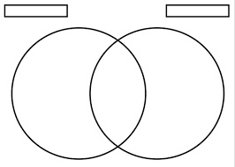
Teaching strategy:
Find two songs with a similar theme.
#1. Work with the vocabulary of the songs
#2. Create a Venn Diagram showing how the songs are similar and different. (see resources at the back of this handout.)

Slide 41
Suggested songs:
Easy songs (for junior or senior) about broken hearted love! (a bit cheesy for today’s students and loads of fun!)
Khaled – Aicha
Roch Voisine - Hélène
See resource section pages 8 & 9 at the back of this package for the song lyrics*

Slide 42
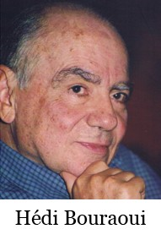
Les poèmes en traduction
Hédi Bouraoui
(Tunisien/Canadien)
Echosmos,
1986 ISBN 0-9691270-2-2 or ISBN 0-9691270-3-0

Slide 43
2 poèmes : play with trying out translation. Hédi Bouraoui
ENFANCE D’AUJOURD’HUI
1 A ton réveil, tu verras ton écorce endurcie
2 Et ton innocence aura pris la forme d’un bouclier
3 On te pousse sans répit à cueillir la rose d’usage
4 Mais ton cœur nie à jamais la bouture des temps
5 D’angoisse et de soucis, ton monde est déjà rempli :
6 Crises aiguisées par une triomphante bêtise
7 Chômage lynchant des corps à peine fleuris
8 Violence s’abrutissant sur une décadence maladive
9 La ronde continue, qu’y a-t-il de nouveau?
10 Une paix qui doit s’acquérir
11 En plongeant dans la boue des mots
12 Et l’harmonie qui refuse de flétrir
13 Se logera dans un silence servi en cadeau.
SONG FOR A CHILD
At dawn bark will harden round you
And your innocence become a shield
They urge you to pluck the usual rose
But your heart rejects the grafts of other times
Your world is already crowded with worries
Triumphant follies sharpen your crises
Apathies lynch bodies hardly blooming
Brute violence and stickly decadence
The round goes on, what’s new?
Peace comes at the end
Of words and days of mud
Harmonies don’t expend
Themselves. And solitude.
*See resource section pages 6 & 7 at the back of this package for the poems*

Slide 44
Une image
Créer à partir
d’une image
Qui suis-je?
Give students the cut
out image.
Ask students to image
what this image could
be.

Slide 45
Qui suis-je?

Slide 46
Qui suis-je?

Slide 47
Poème encadré (framework poem)
Angèle Arsenault – Je veux toute toute toute la vivre ma vie
Directions: Choose a poem or song that has a repetitive structure.
Give students the specific grammatical framework and they do a riff on it!
*find this resource at the back of the package page 14*

Slide 48
Poème de prédiction – Apprivoise-moi. De nos études du Petit Prince (St. Exupèry)
Directions: I selected key nouns, verbs, adverbes, adjectives from a section of ‘le petit prince’
Materials: large paper, glue and colourful felt pens or pencil crayons.
Pre-cut the words and put in an envelope.
Ask students to arrange them into at least a 12-16 line poem. Promote the idea of stanzas.
At the end of the study of the story, revisit their poems and they will be surprised at their accuracy! (see page 15 of resource package)

Slide 49
Le napperon (placemat)
*find this resource at the back of the package*

Slide 50
L’histoire multi-sensorielle
Directions:
Using this graphic organizer, you can approach texts, soundscapes etc.
Have it on hand!
find this resource at the back of the package*

Slide 51
Les films onf
Les droits au cœur

Slide 52
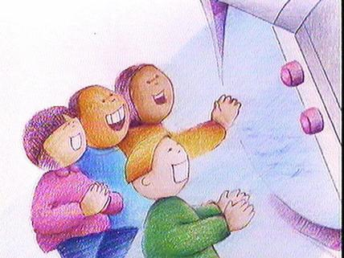
NFB/ONF animated films…..
Télé tango
Children watch television
And then ‘play out’ what
they see.
Theme: media
violence & early childhood.
lien télé tango
L’enfant a le droit à son plaisir.
(See students’ poems in the package)

Slide 53
L’orange
Child goes hungry in class and takes an orange
From the garbage.
Theme: hunger, homelessness, food security.
L’enfant a le droit de manger à sa faim

Slide 54
Resources
Mon enfance au Viêt-nam
Voyage I – Prentice Hall
Jacques Cousteau
Voyage II – Prentice Hall
Hédi Bouraroui Echosmos,
1986 ISBN 0-9691270-2-2 or ISBN 0-9691270-3-0

Slide 55
Resources / Les ressources
1. Find the link to NFB’s Rights From the Heart / Les droits au coeur.
List of the rights from the UN convention for the rights of children
http://www3.nfb.ca/sg/34595.pdf

Slide 56
Please find this material in electronic form at
www.pollydobiecorefrench.weebly.com
www.pollydobiecorefrench.weebly.com
Polly Dobie (Core French 8-12, English, Creative Writing)
Point Grey Secondary
pdobie@vsb.bc.ca
School phone:604-713-8220

